Slide 1




The Dictionary app
In this presentation, I will show a non-functional user interface prototype.

Slide 2
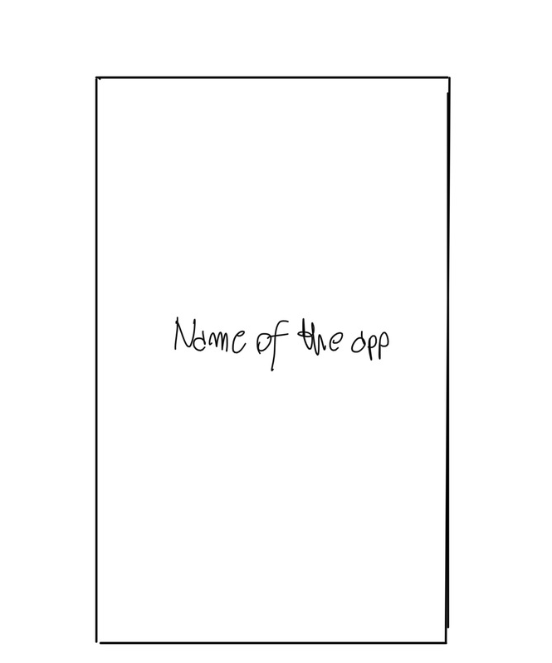
Start screen for the app
In the middle there will be the name of the app

Slide 3
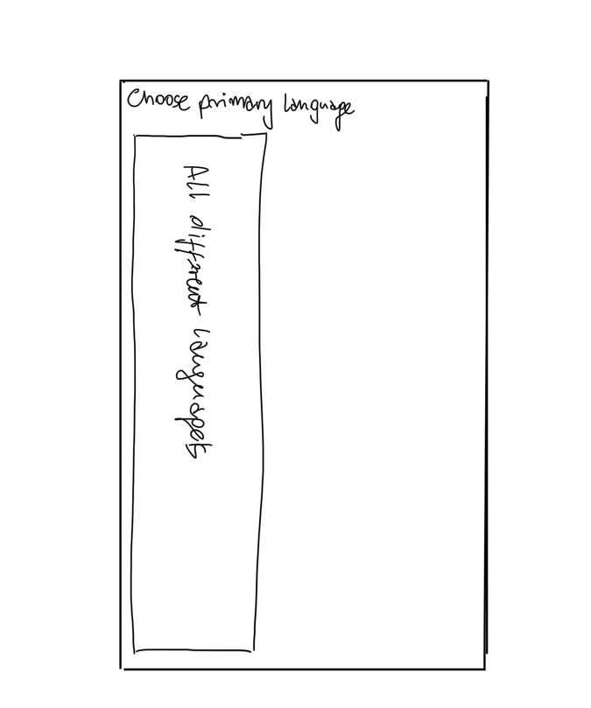
Choose Primary Language
In the design there is the title saying “Choose primary language”
There is an item list with different languages to choose from
The User will choose his primary language that will be used in ”dictionary”.
By pressing on any language, it will take User to next screen to choose language User want to learn

Slide 4
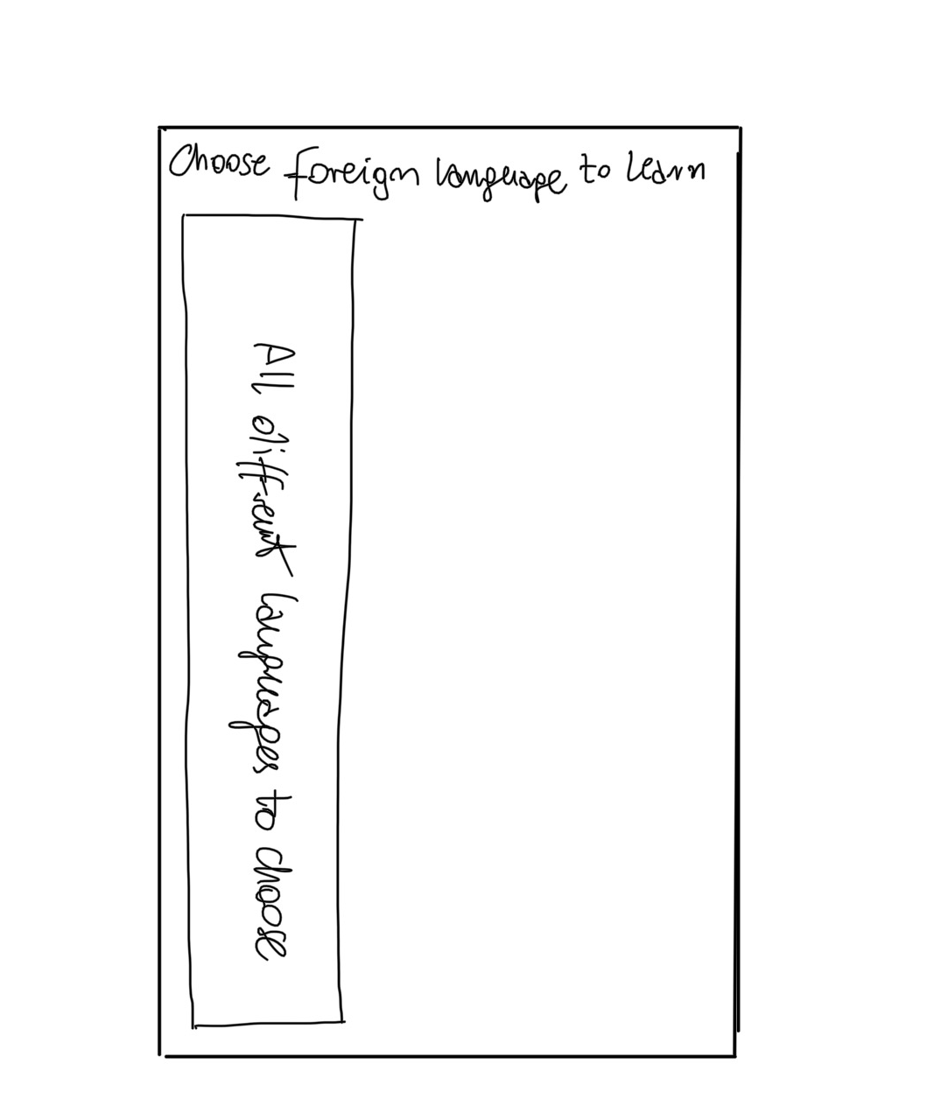
Choose Foreign Language to learn
In the design there is title saying: “Choose Foreign Language to learn”.
There is an item list with different languages to choose from(making sure if the user will choose the same language twice to let them know to get different one).
The User will choose his language to learn that will be used in ”dictionary”.
By pressing on language, it will take User to the next screen which is “Dictionary”.

Slide 5
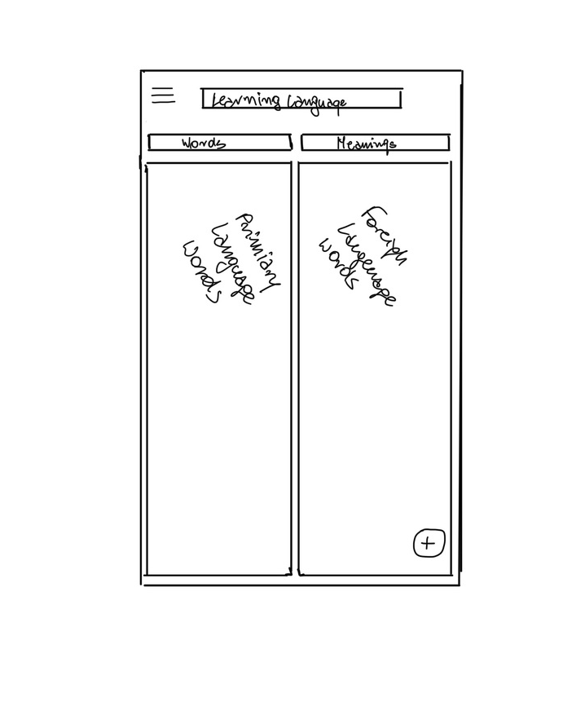
The “Dictionary”
By pressing on hamburger button(top left corner), it will show two settings.
On the top of the screen, there will be language that you choose in previous screen.
On the left there will be words and list of words and list of words added under it
On the right there will be the meaning of words from the left side and list of words added under it
Bottom right corner there will be snackbar to add words.
After adding words, User will be able to make changes to it by simply pressing on it.

Slide 6
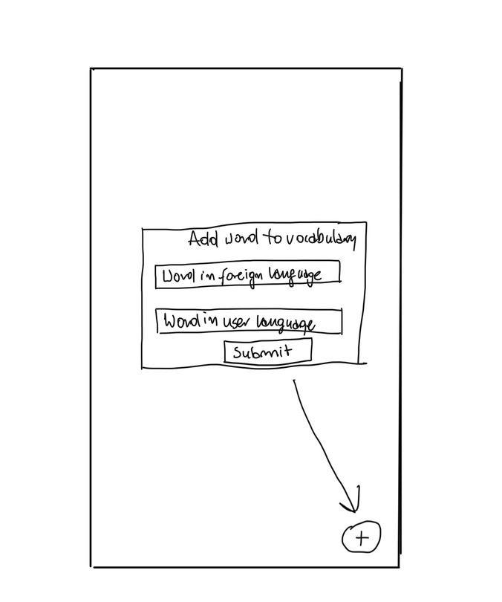
Add Word
By pressing snackbar(circled “+” button) will be able to add words to “Dictionary
On the top of pop up will be something like “Add word to vocabulary”.
Second from the top User will need to input word in a foreign language
Third form the top will be User’s language meaning of the word.
The last one will be "submit" button to complete adding the word and meaning.

Slide 7
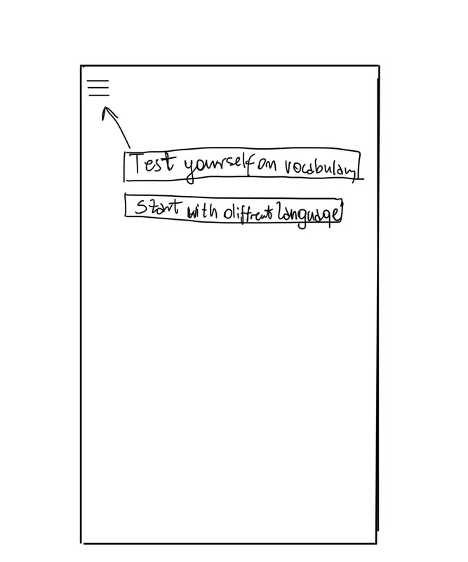
Hamburger button
By pressing on hamburger button there will be two settings to choose from.
One of them will be to let User test himself/herself on the words added(there will be requirement 5 words minimum to test)
To start from the beginning User will be able to press the second option “Start with different language”. After that, the app will delete all words added and moved to “Choose primary language” screen.

Slide 8
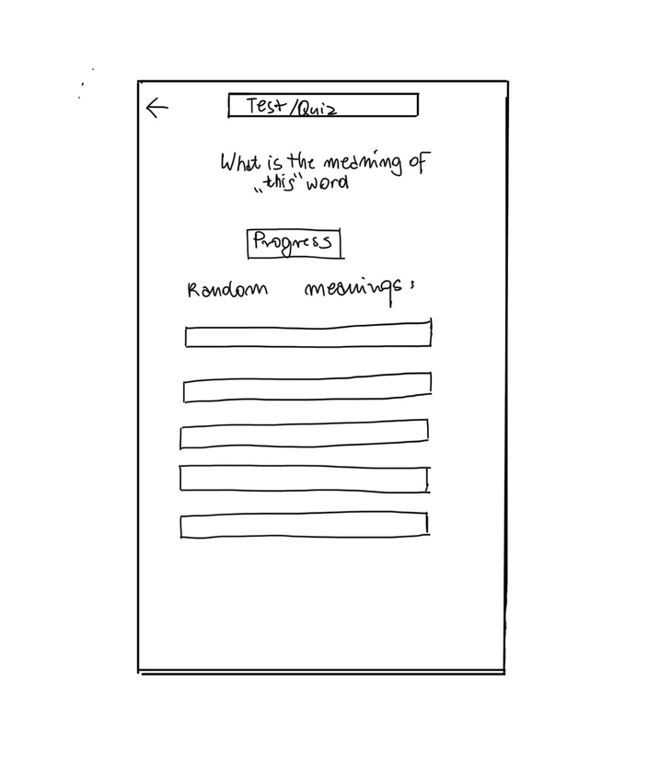
Test/Quiz
In the top left corner if the user would like to go back to “dictionary” screen without finishing the test, will be able to press back arrow.
On the top word will appear and User will need to find the right meaning of it from few random words generated from a dictionary.
There will be a place where User can see the progress.
There will be generated words from the dictionary to choose the right meaning from.

Slide 9
Thank you

